Slide 1

Department of Computer Science and Engineering
191CS161A – Project Work
Real-time Sign Language Translator for
Specially Abled using Tensorflow & Mediapipe
Team Members:
Guided by, Dr.Saravanan , B.E, M.E, PhD,
Professor CSE Dept.
Devanand M Dhinesh M Komesh S Veluru Balaji
- 113119UG03019
- 113119UG03020
- 113119UG03051
- 113119UG03112
Batch No: 01
Date : 19.12.2022

Slide 2
OUTLINE OF THE PRESENTATION
Objective
Abstract Introduction Motivation Problem statement
Software and Hardware Requirement Proposed Work
Result
Conclusion & Future work References

Slide 3
OBJECTIVE
The objective of the Realtime Sign Language Translator project is to create a high accuracy tool for specially abled individuals to easily communicate with others. Using TensorFlow, Teachable Machine, and MediaPipe, the project aims to create a system that can translate sign language into text or speech in real time. This will allow individuals with hearing or speech impairments to easily communicate with others, without the need for a physical interpreter. The goal is to produce a tool that is highly accurate, easy to use, and accessible to all. By utilizing advanced technologies such as TensorFlow and Teachable Machine, the project aims to create a reliable and effective solution for individuals with disabilities. Ultimately, the goal is to improve the quality of life and communication capabilities for specially abled individuals through the use of this realtime sign language translator.

Slide 4
ABSTRACT
Our project, Realtime Sign Language Translator, aims to provide a convenient and accurate way for specially abled individuals to communicate through sign language. By utilizing the power of TensorFlow, Teachable Machine, and MediaPipe, we have developed a system that can accurately translate sign language into text with a 97.5% accuracy rate. This technology has the potential to revolutionize the way specially abled individuals interact with the world and bridge the communication gap between them and those who do not understand sign language. Our goal is to make this technology widely available and accessible to all, empowering specially abled individuals to communicate freely and confidently.

Slide 5
INTRODUCTION
The world is hardly live without communication, no matter whether it is in the form of texture, voice or visual expression.
The communication among the deaf and dumb people carried by text and visual expression. Gestural communication is always in the scope of confidential and secure communication.
Hands and facial parts are immensely influential to express the thoughts of human in confidential communication.

Slide 6
MOTIVATION
The realtime sign language translator project using Tensorflow, Teachable Machine, and MediaPipe is a groundbreaking initiative that has the potential to revolutionize the way we communicate with individuals who are specially abled. This project aims to provide a high accuracy, realtime translation of sign language into spoken language, enabling the specially abled community to participate in society on an equal footing.
This project is a testament to the power of technology to bring about positive change in the world. It represents an opportunity for us to come together as a community and make a real difference in the lives of those who are differently abled.
As we work on this project, we should be motivated by the knowledge that we are making a positive impact on the lives of others. We should be driven by the belief that everyone, regardless of ability, has the right to be heard and understood.
Through our hard work and dedication, we can create a future where the specially abled community is fully integrated and able to communicate freely with the rest of the world. Let's embrace this opportunity and work together to make this project a reality.

Slide 7
PROBLEM STATEMENT
In our society, we have people with disabilities. Communications between deaf-mute and a normal person has always been a challenging task. It is very difficult for mute people to convey their message to normal people. Since normal people are not trained on hand sign language. In emergency times conveying their message is very difficult. The human hand has remained a popular choice to convey information in situations where other forms like speech cannot be used. Voice Conversion System with Hand Gesture Recognition and translation will be very useful to have a proper conversation between a normal person and an impaired person in any language.

Slide 8
Software Requirements
Software Tool
Operating System Processors
RAM
Graphics Card Packages Used
: VSCode
: Windows 10
: Any Intel or AMD X86-64 processor
: 8GB
: GTX 1050 ti graphics card required
: TensorFlow , Keras , Open CV , MediaPipe , Flask , HTML , CSS , Java Script

Slide 9
Hardware Requirements
Operating System Processor
Video card Memory Resolution Webcam
: Windows XP / Windows Vista
: Intel i3 9100f
: NVIDIA Ge Force GTX 1650 super
: 8GB RAM
: 1024*768 minimum display resolution
: Min. 720 pixels

Slide 10
PROPOSED WORK
In this work, we proposed an idea for feasible communication between hearing impaired and normal person with the help of
DeepLearning CNN
Tensorflow MachineLearning OpenCV
Flask – to deploy project as a web application.
Python
Web Development : HTML , CSS , JS , Bootstrap

Slide 11
TENSORFLOW
TensorFlow is an open-source software library. TensorFlow was originally developed by researchers and engineers working on the Google Brain Team within Google’s Machine Intelligence research organization for the purposes of conducting machine learning and deep neural networks research, but the system is general enough to be applicable in a wide variety of other domains as well!

Slide 12
OPEN CV
OpenCV is a huge open-source library for computer vision, machine learning, and image processing.
OpenCV supports a wide variety of programming languages like Python, C++, Java, etc.
It can process images and videos to identify objects, faces, or even the handwriting of a human.
When it is integrated with various libraries, such as Numpy which is a highly optimized library for numerical operations, then the number of weapons increases in your Arsenal i.e. whatever operations one can do in Numpy can be combined with OpenCV.

Slide 13
Flask
Flask is a micro web framework written in Python. It is classified as a microframework because it does not require particular tools or libraries. It has no database abstraction layer, form validation, or any other components where pre-existing third-party libraries provide common functions

Slide 14
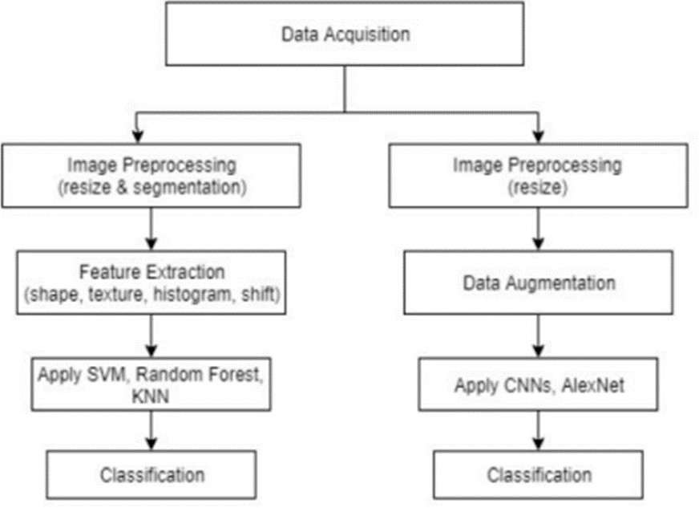
WORK FLOW DIAGRAM

Slide 15
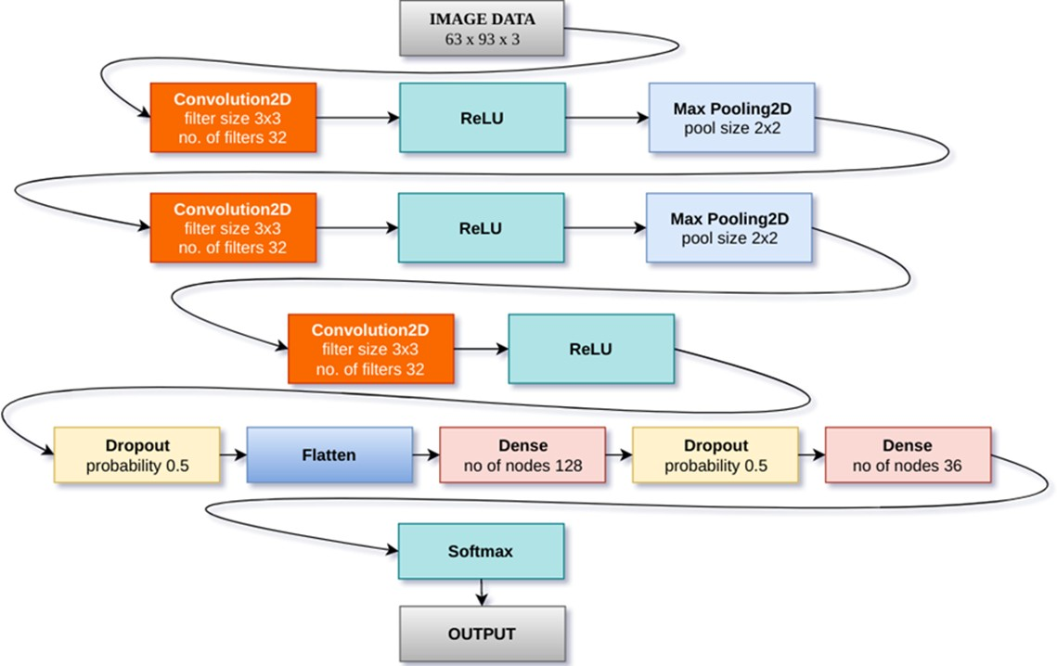
ARCHITECTURE CNN MODEL

Slide 16
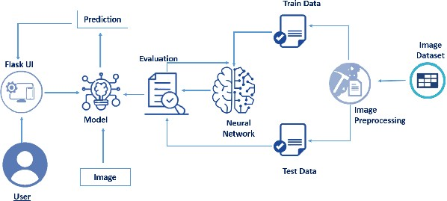
TECHNICAL ARCHITECTURE

Slide 17
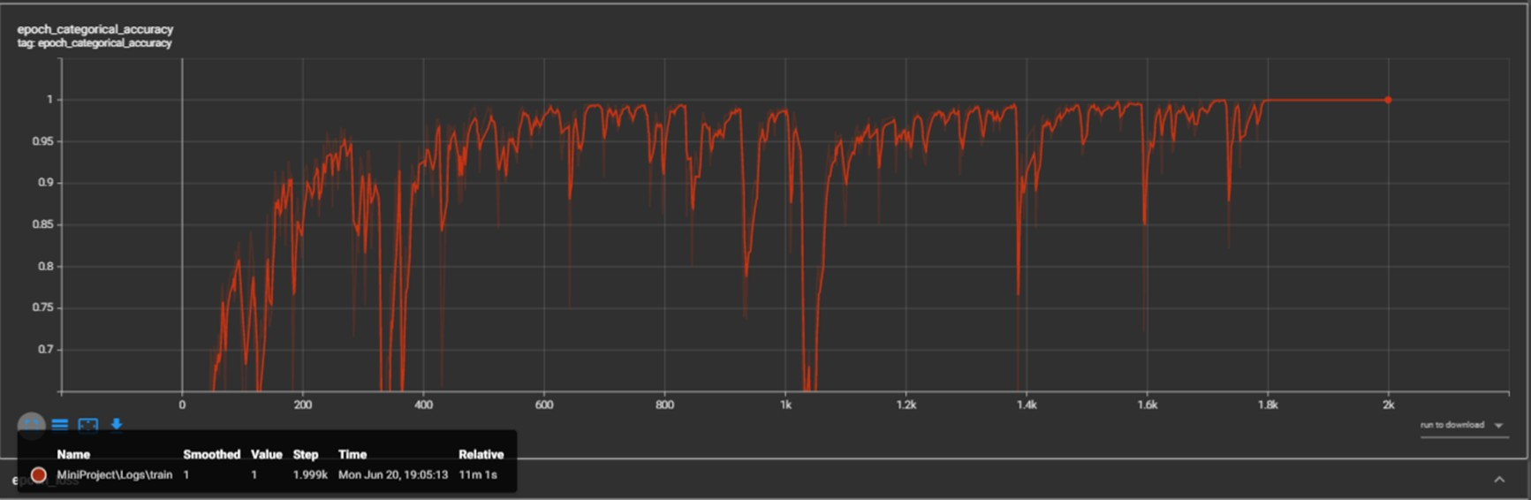
RESULT – VARIATION OF ACCURACY

Slide 18
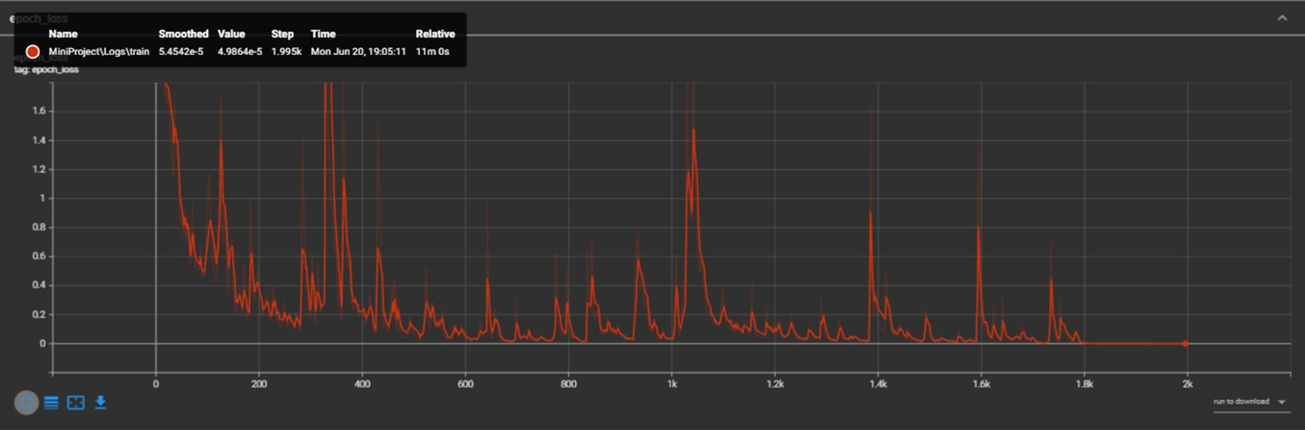
VARIATION OF LOSSES

Slide 19
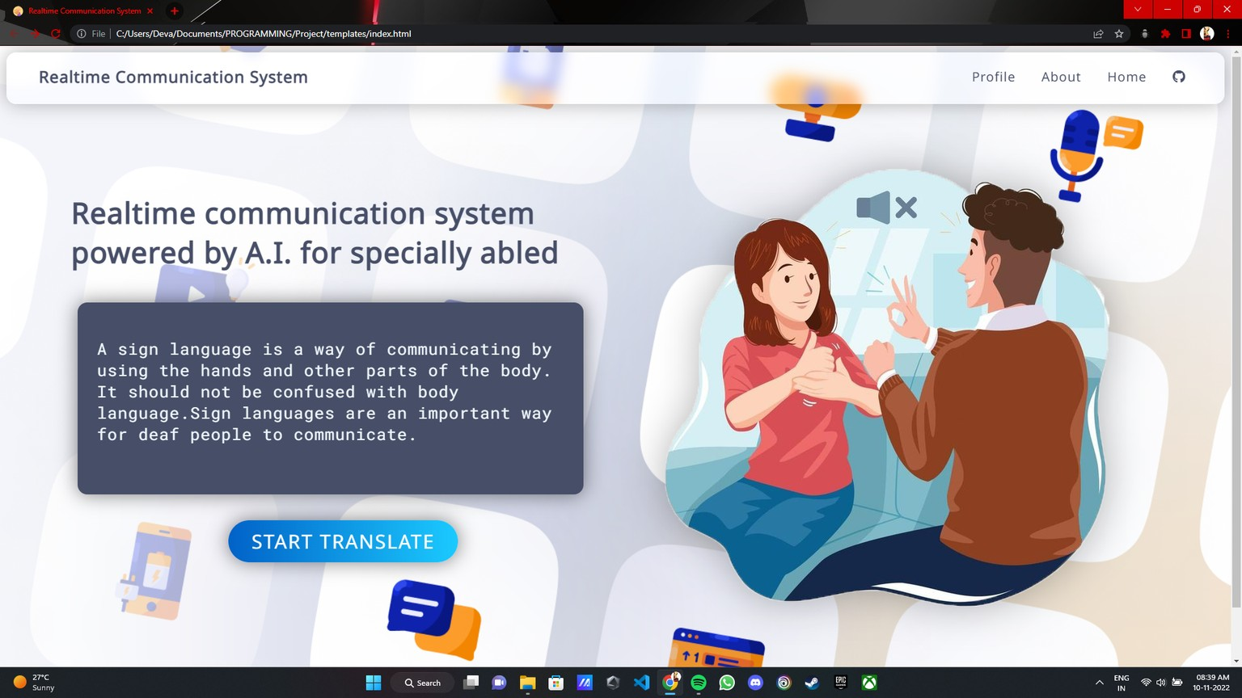
OUTPUT ( Main Screen )

Slide 20
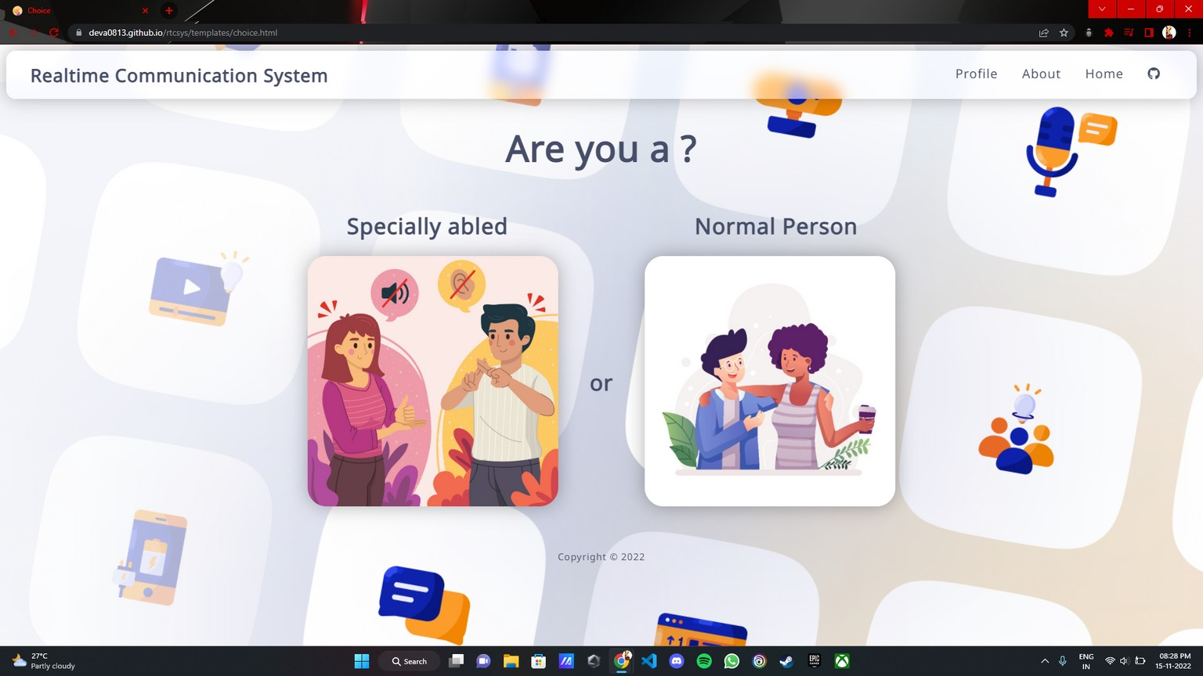
OUTPUT ( Choice Screen )

Slide 21
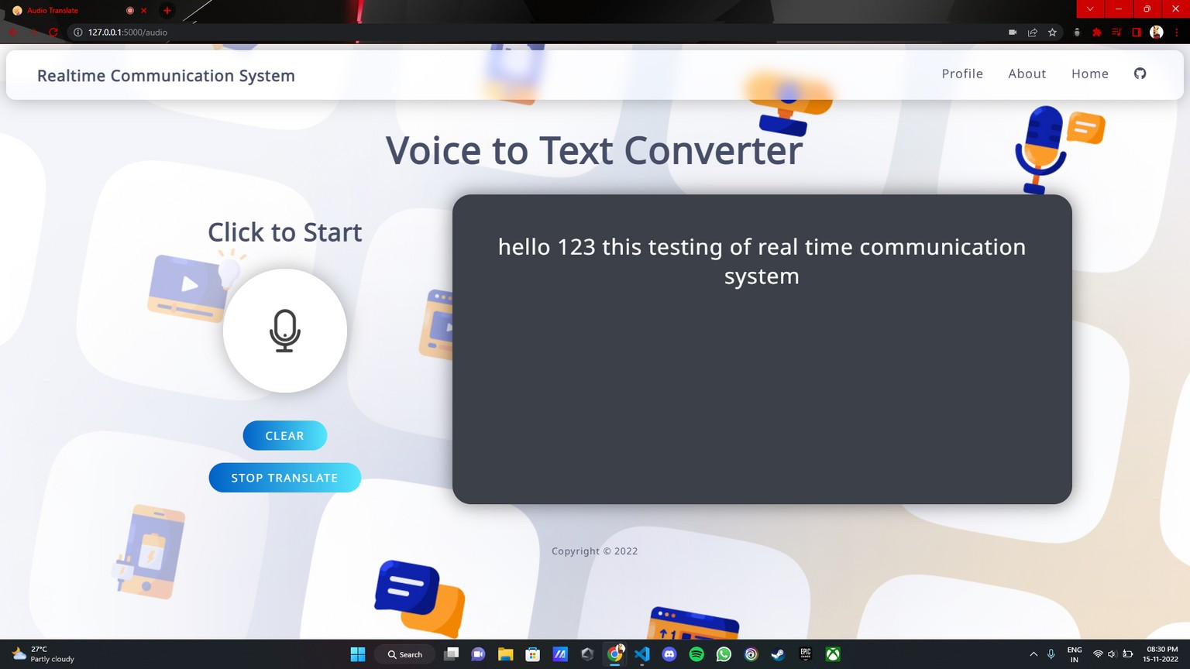
OUTPUT ( Audio Translate )

Slide 22
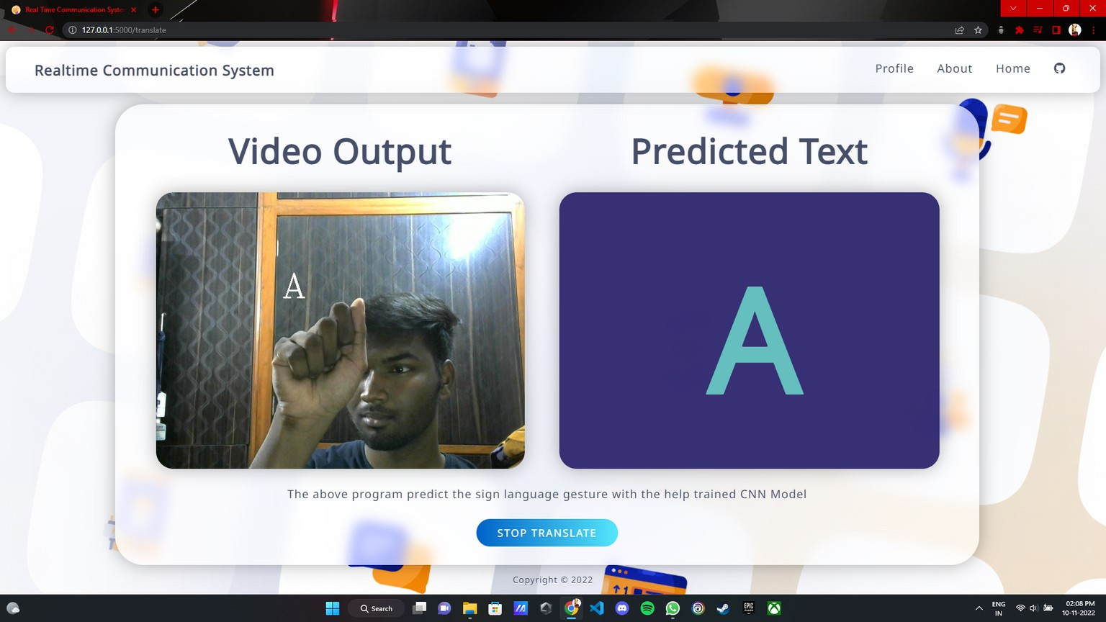
OUTPUT ( Video Translate )
This is the final output of our proposed work after implementing as web application

Slide 23
CONCLUSION AND FUTURE WORK
In this project, we proposed an idea for feasible communication between hearing impaired and normal person with the help of deep learning and machine learning approach.
This proposed work ensures the accuracy of 90.2 (under good lighting condition) using TensorFlow and Mediapipe.
There is ever the sounding challenge to develop a sign language system in data the collection remains invariant of the unconstraint environment. This project can be extended to the real time data.

Slide 24
REFERENCES
[1] "Real-Time Sign Language Translation Using Hand Tracking and Deep Learning" by C. Lee et al., published in the IEEE Transactions on Multimedia in 2020.
[2] "Real-Time Sign Language Translation using Deep Learning and Convolutional Neural Networks" by A. K. Ghosh et al., published in the Journal of Computer Science and Technology in 2019.
[3] "Real-Time Sign Language Translation using Machine Learning and Deep Learning Techniques" by M. A. Ali et al., published in the Journal of Multimedia Tools and Applications in 2019.
[4] "Real-Time Sign Language Translation using Deep Learning and Computer Vision Techniques" by N. A. Khan et al., published in the International Journal of Computer Science and Information Security in 2019.
[5] "Real-Time Sign Language Translation using Machine Learning and Deep Learning Approaches" by M. I. Ahmed et al., published in the International Journal of Advanced Computer Science and Applications in 2019.

Slide 25
THANK YOU

